Slide 1
CUSTOMER DEMOGRAPHICS AND PURCHASE BEHAVIOR ANALYSIS...
G. Kiruthik Chakra | BADM-WD-T-B9

Slide 2
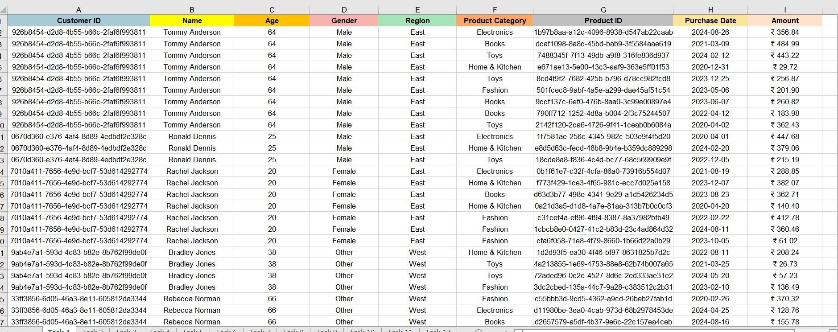
TASK-1 STYLING TABULATION
Format the dataset to improve readability.
Bold headers, apply alternating row colors, and format the Amount column as currency.
Results:

Slide 3
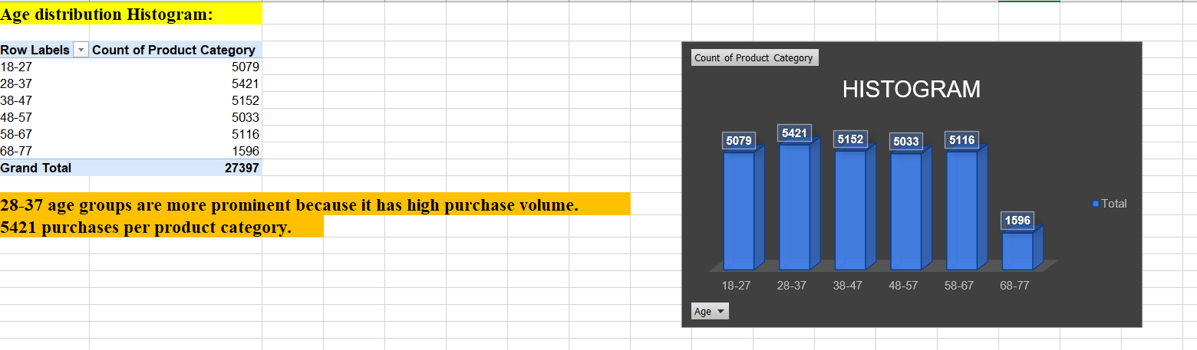
TASK-2 AGE DISTRIBUTION HISTOGRAM
Visualize customer age distribution.
Group ages into bins and create a histogram to analyze which age groups are most prominent.
Results:

Slide 4
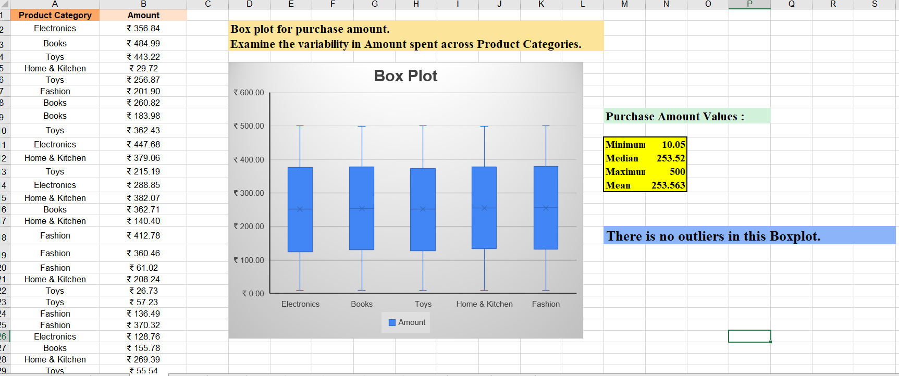
TASK-3 BOX PLOT FOR PURCHASE AMOUNT
Examine the variability in Amount spent across Product Categories.
Plot a box plot to identify outliers and the median purchase amounts.
Results:

Slide 5
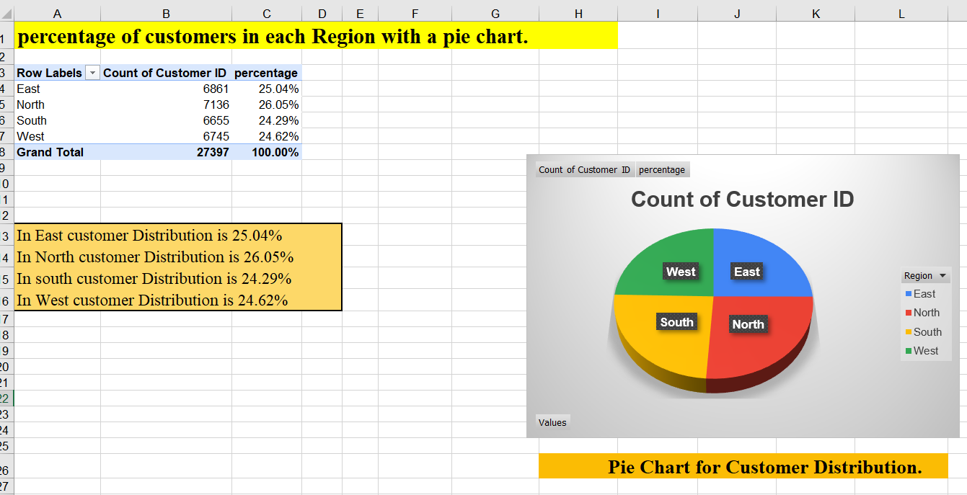
TASK-4 PIE CHART FOR CUSTOMER DISTRIBUTION
Represent the percentage of customers in each Region with a pie chart.
Display percentages and highlight the region with the highest customer base.
Results:

Slide 6
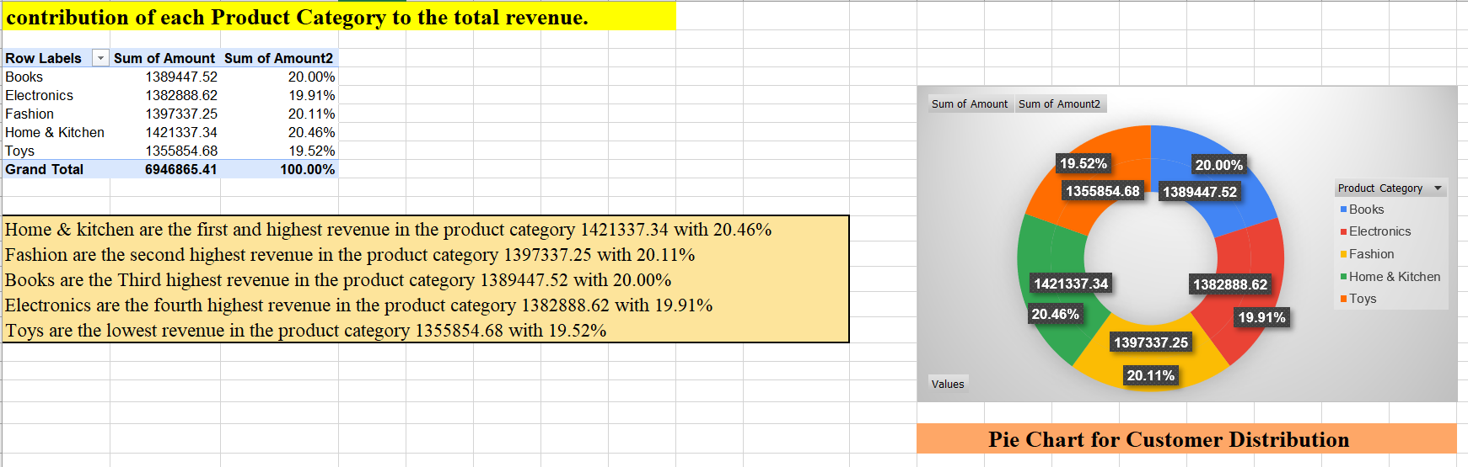
TASK-5 DONUT CHART FOR PRODUCT REVENUE CONTRIBUTION
Show the contribution of each Product Category to the total revenue.
Use a donut chart to display the data visually.
Results:

Slide 7
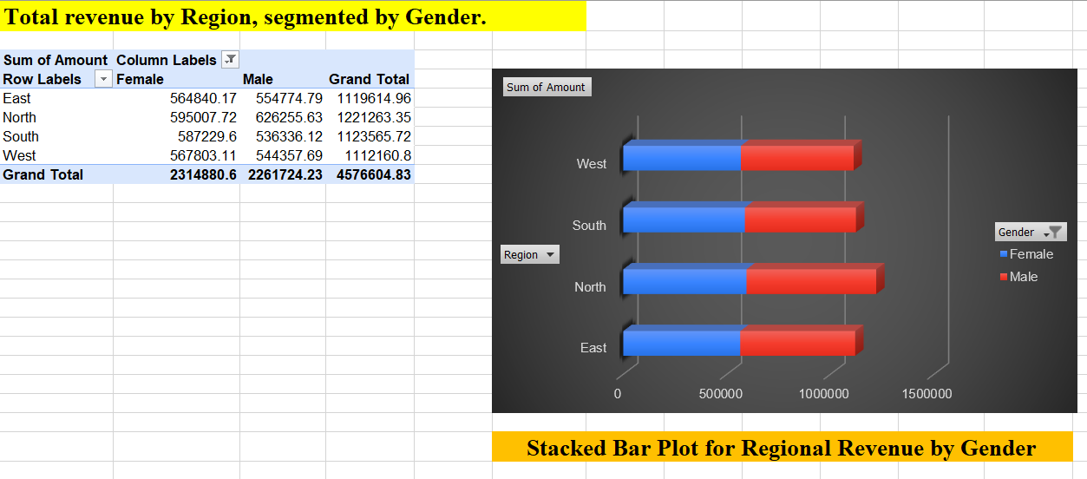
TASK-6 STACKED BAR PLOT FOR REGIONAL REVENUE BY GENDER
Analyze total revenue by Region, segmented by Gender.
Create a stacked bar plot for better comparison.
Results:

Slide 8
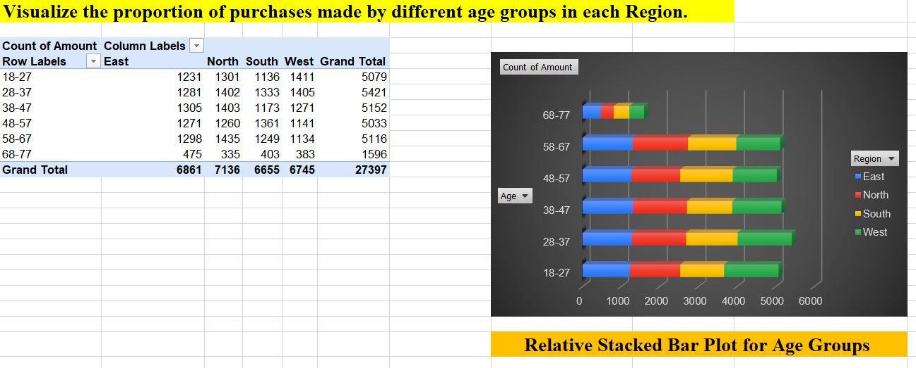
TASK-7 RELATIVE STACKED BAR PLOT FOR AGE GROUP
Visualize the proportion of purchases made by different age groups in each Region.
Represent data proportionally in a stacked bar plot.
Results:

Slide 9
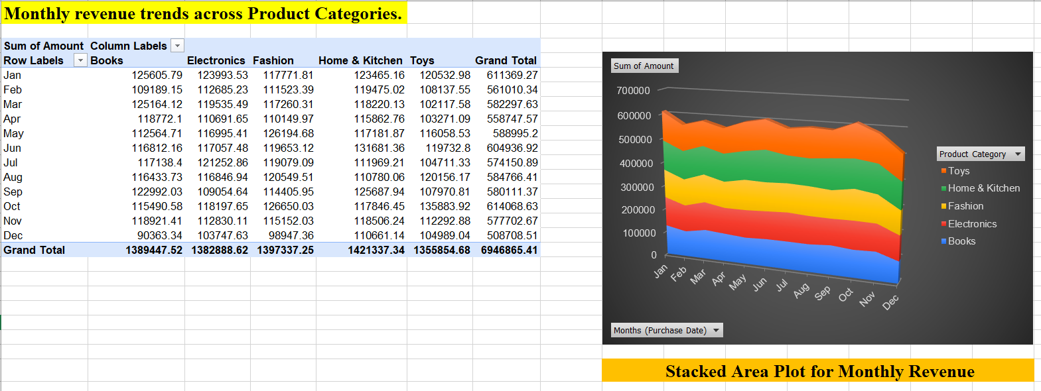
TASK-8 STACKED AREA PLOT FOR MOTHLY REVENUE
Analyze monthly revenue trends across Product Categories.
Use a stacked area plot to observe how each category contributes over time.
Results:

Slide 10
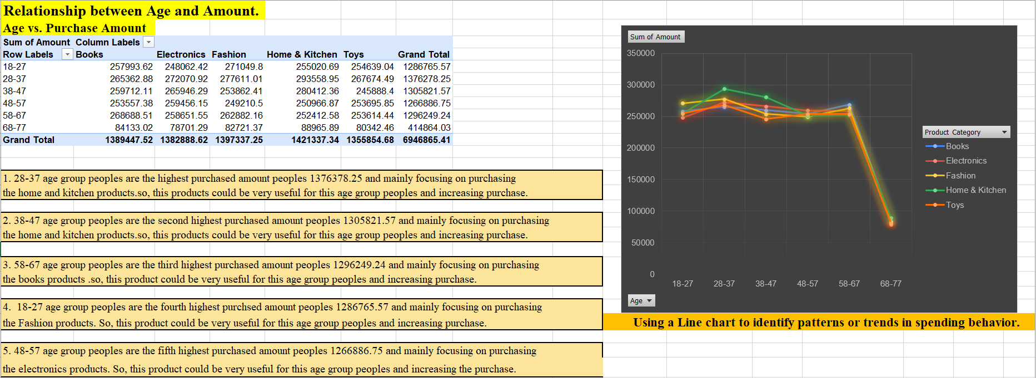
TASK-9 SCATTER PLOT FOR AGE VS PURCHASE AMOUNT
Explore the relationship between Age and Amount.
Use a scatter plot to identify patterns or trends in spending behavior.
Results:

Slide 11
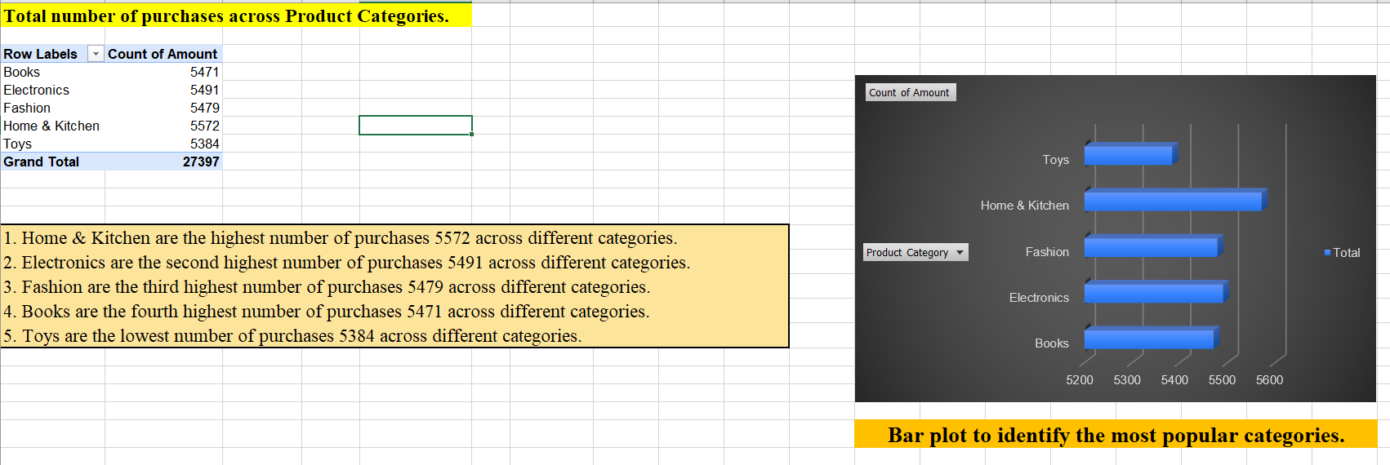
TASK-10 BAR PLOT FOR TOTAL PURCHASES
Compare the total number of purchases across Product Categories.
Create a bar plot to identify the most popular categories.
Results:

Slide 12
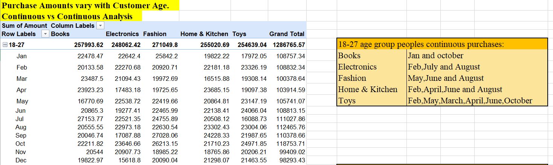
TASK-11 CONTINUOS VS CONTINUOS ANALYSIS
Visualize how Purchase Amounts vary with Customer Age.
Plot continuous variables to identify correlations or trends.
Results:

Slide 13
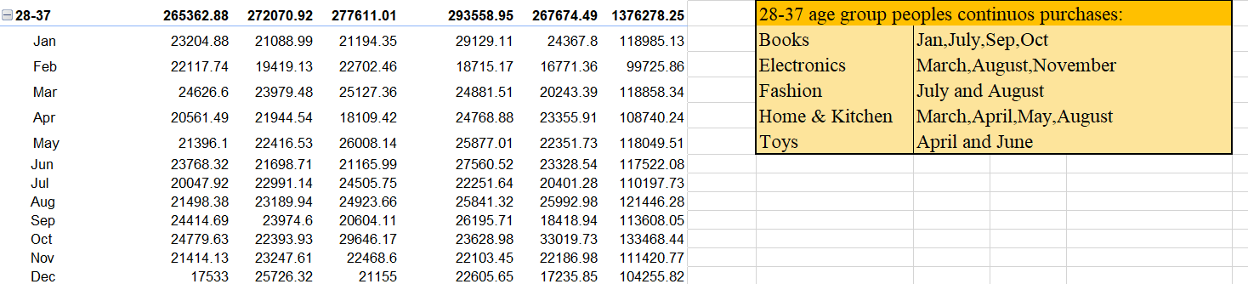
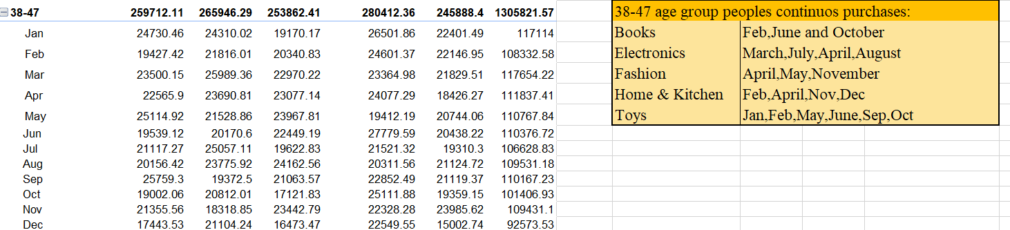

Slide 14
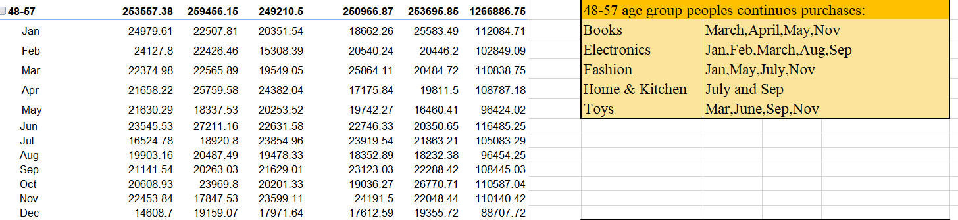
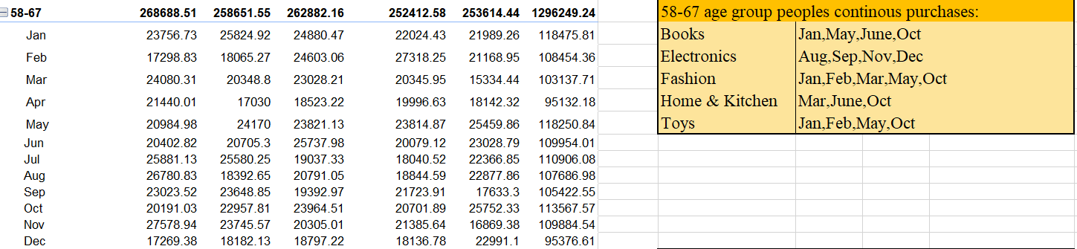

Slide 15
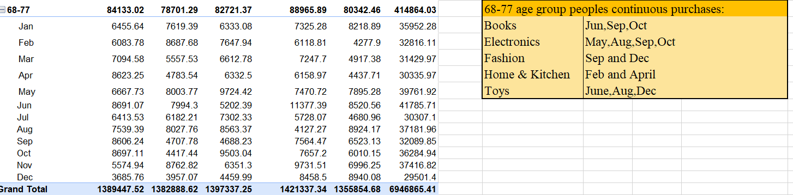
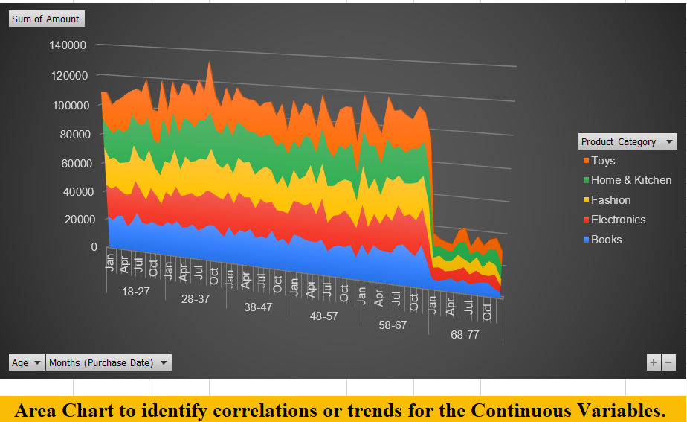

Slide 16
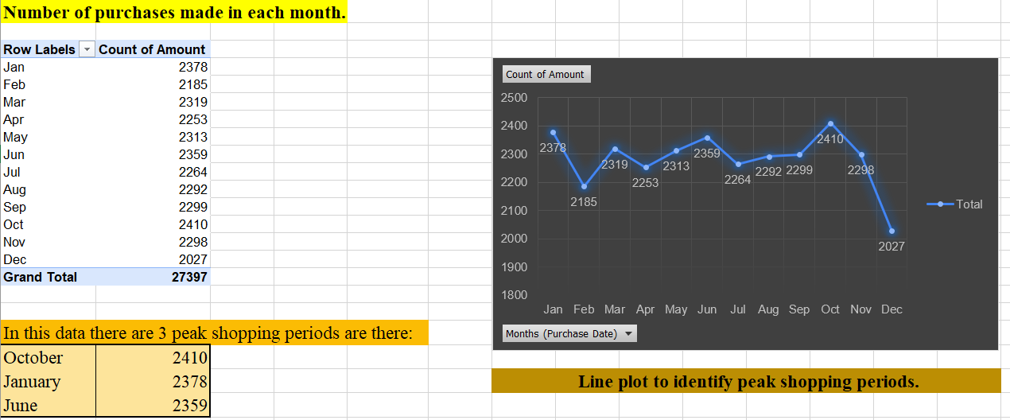
TASK-12 LINE PLOT FOR MONTHLY PURCHASE TRENDS
Track the number of purchases made in each month.
Use a line plot to identify peak shopping periods.
Results:

Slide 17
Here is the link for this project findings and calculations excel sheet:
https://docs.google.com/spreadsheets/d/1NrZkdUHsAwjMTRAeU-BTjsh0FE6lIpOV/edit?usp=sharing&ouid=113433772495243206201&rtpof=true&sd=true

Slide 18
THANKYOU…

